Slide 1


Proxy Preview 2024
Download the full report at
www.proxypreview.org
March 14, 2024
Notes:
Continued political $ focus: “connective tissue”

Slide 2
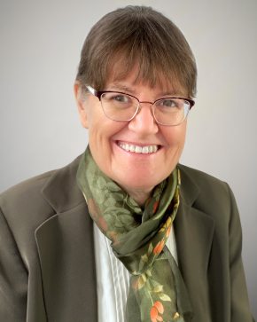
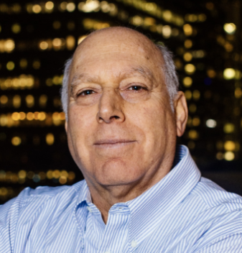
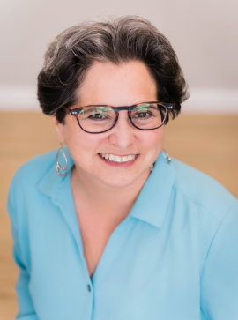
Featured Speakers
Heidi Welsh
Sustainable Investments Institute (Si2)
Michael Passoff
Proxy Impact
Shelley Alpern
Rhia Ventures
Notes:
Continued political $ focus: “connective tissue”

Slide 3
Agenda
✓ Introduction (3 min)
Andrew Behar, As You Sow
✓ 2024 Proxy Season Overview (15 min)
Heidi Welsh, Si2
✓ Climate & Energy (10 min)
Michael Passoff, Proxy Impact
✓ Social Topics: Political Spending Misalignment, Reproductive & Maternal Healthcare (10 min)
Shelley Alpern, Rhia Ventures
✓ Q&A (15 min)
moderated by Andrew Behar
✓ Closing Remarks (2 min)
Heidi Welsh, Michael Passoff, Shelley Alpern
✓ Conclusion (2 min)
Andrew Behar
Notes:
Continued political $ focus: “connective tissue”

Slide 4
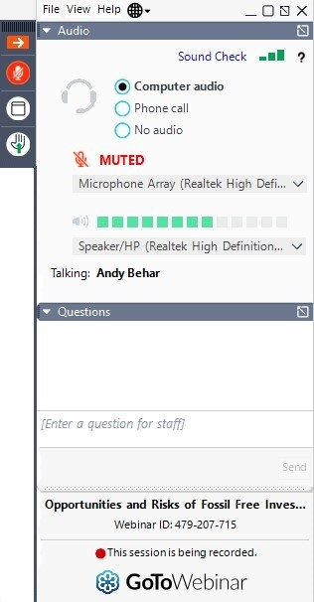
General Information
Use the Q&A window to send us your questions
Q&A Window
Download the full report at
www.proxypreview.org
Notes:
Continued political $ focus: “connective tissue”

Slide 5
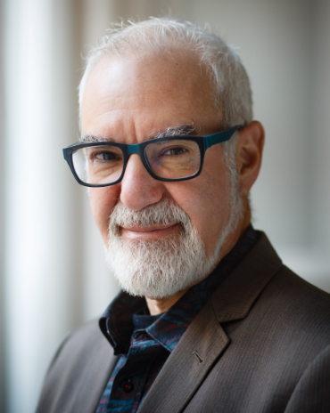

Introduction
Andrew Behar
CEO
As You Sow
Notes:
Continued political $ focus: “connective tissue”

Slide 6
About As You Sow
Mission: to promote environmental and social corporate responsibility through shareholder advocacy, coalition building, and innovative legal strategies
Founded in 1992 on the belief that corporations must be an active part of the solutions to society’s environmental and human rights issues
30-year track record of promoting values-aligned investing and securing positive, lasting corporation change
We communicate directly with corporate executives to collaboratively develop and implement business models that reduce risk, benefit brand reputation, and protect long-term shareholder value while simultaneously bringing about positive change for the environment and human rights
Notes:
Continued political $ focus: “connective tissue”

Slide 7


2024 Proxy Season Overview
Heidi Welsh
Executive Director
Sustainable Investments Institute (Si2)
Notes:
Continued political $ focus: “connective tissue”

Slide 8
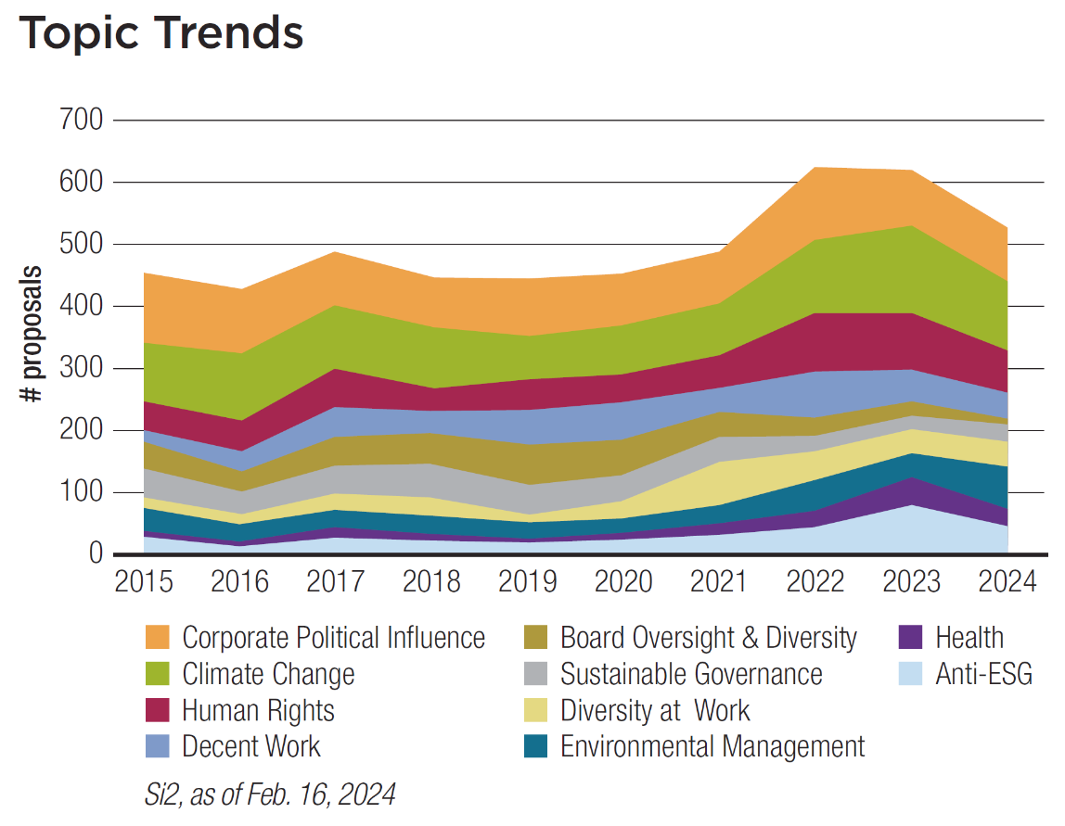
Notes:
Continued political $ focus: “connective tissue”

Slide 9
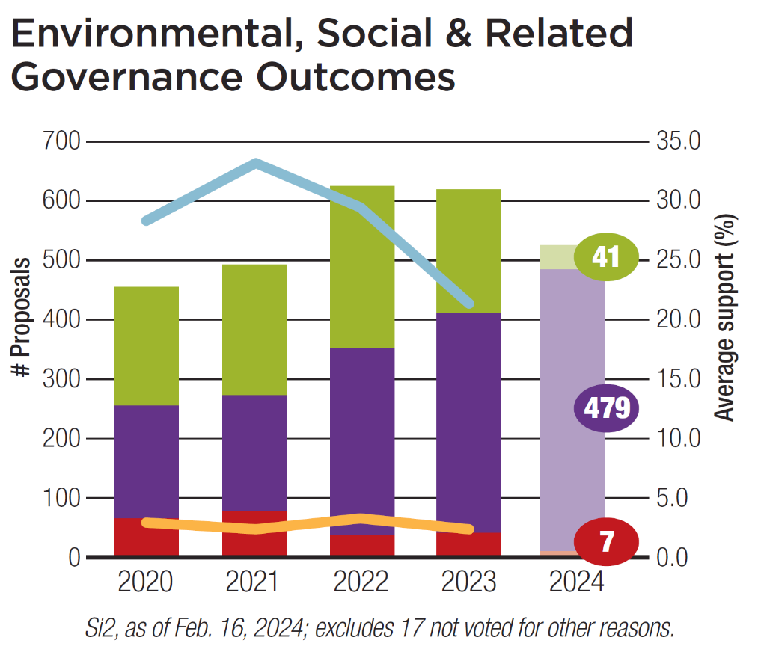
Average support for pro-ESG continued downward slide in 2023 – are we at bottom?
“Big Three” voting most impactful, but mix of:
  Legal threats to managers
  Shifts in proposal content
  Uncertainty on SEC climate rule
  Short-term energy prices up from wars
  Political maneuvering
No anti-ESG support but overall “chill” on most but not all topics

Slide 10
Outcomes Update
As of March 12:
Withdrawals will increase – how much?
437 pending (424 same time last year)
# voted in 2023 sharply up
– will it continue?
Omissions down sharply since ‘22, but more challenges this year
Anti-ESG filings will grow

Slide 11
Outcomes of SEC No-Action Challenges
As of March 12:
2021 SEC shift = less success for companies in 2022
In 2023, fewer challenges but relatively more success for companies
In 2024, increase in challenges to “normal” level
Focus remains on “ordinary business” specificity
Still to come: 72 challenge await response from SEC staff

Slide 12
Vote Distribution
Fewer majority votes
Level of investor dissent remains significant: more proposals than ever over 20%
Increase in low votes (<5%), led by anti-ESG and their early 2024 votes still tiny

Slide 13
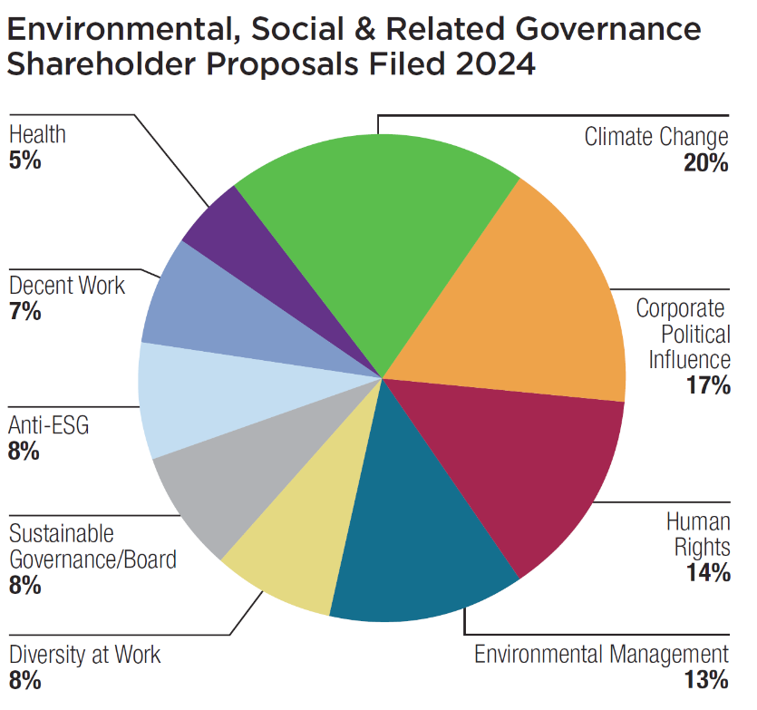
Biggest Shifts in Filings
MORE
Environmental management (animal ag) up 7%
Proxy voting issues up 2x (but governance down)
Anti-ESG: Total unknown but increase so far
FEWER:
Climate change (12 additional on climate governance)
Reproductive health
Board oversight & diversity
Decent work down from many more 3 years ago

Slide 14
Past and Projected Votes – Top Issues
(projected)

Slide 15
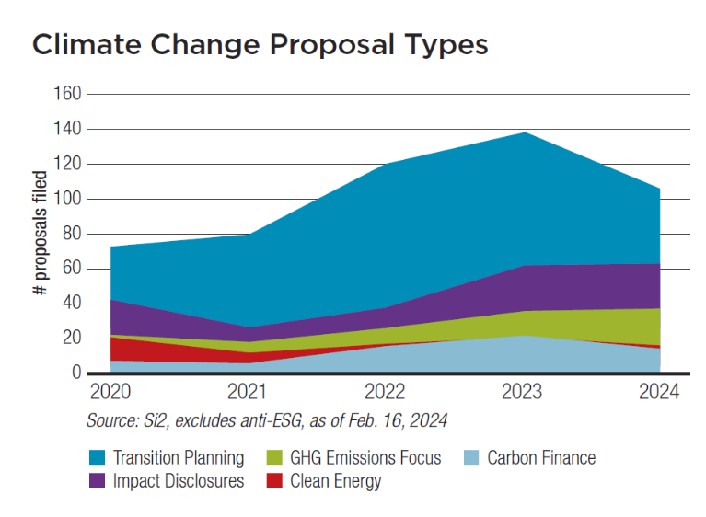
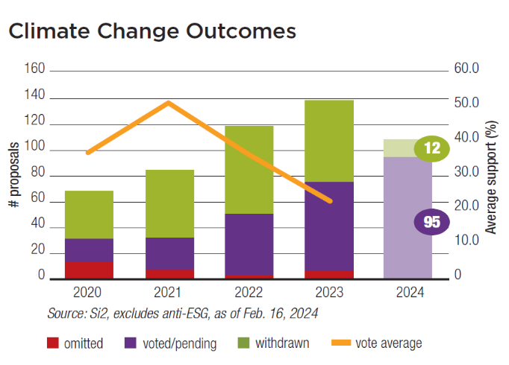
New Issues, Key Themes in 2024
Environment
Climate Change (106 filed, down ~20 from last year)
  Biggest focus: Transition plans with mix/match of Scopes (1, 2, 3) and timeframe (short/medium/long-term)
  Biggest question: Impact of new SEC rule lacking Scope 3, will votes go back up?
NEW:
Task Force on Nature-Related Financial Disclosures
Clean Energy Supply Financing Ratio (JPMorgan will report)
More “just transition”
ExxonMobil lawsuit against “illegitimate” investors

Slide 16
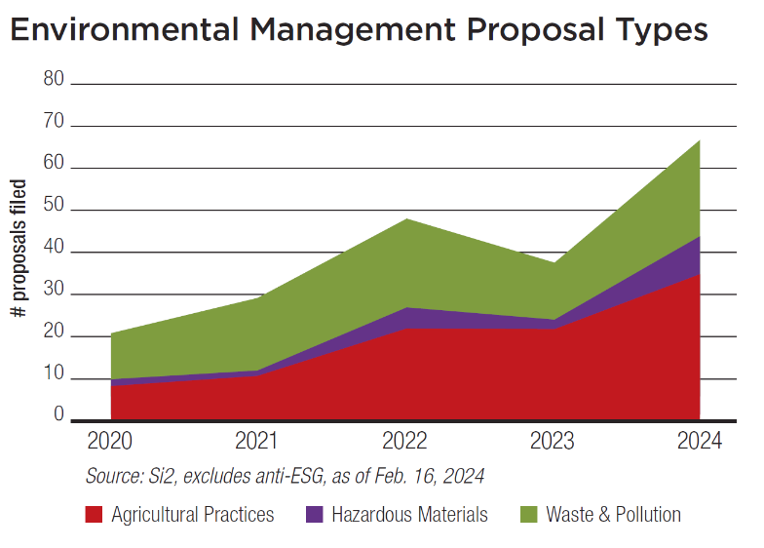
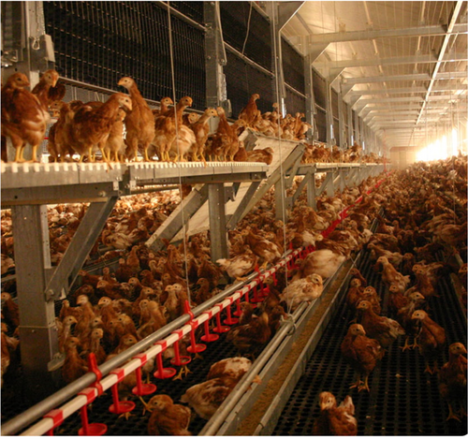

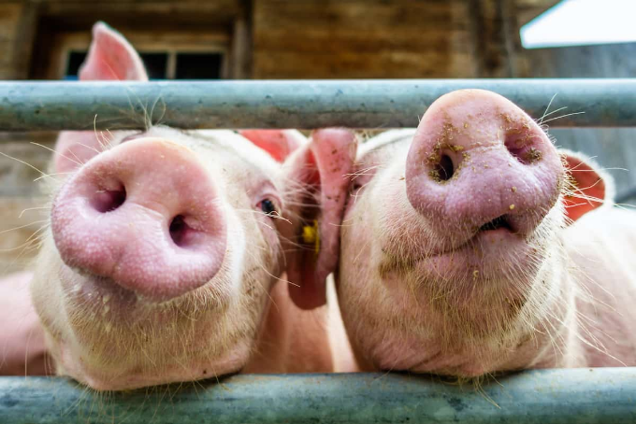
New Issues, Key Themes in 2024
Environment
Environmental Management (68, up from 38 last year)
    Agriculture — More on eggs, pigs: performance on earlier pledges by food & restaurant companies?
  Waste/Pollution — mostly plastic production & use
NEW: Deep-sea mining – GM, Tesla

Slide 17
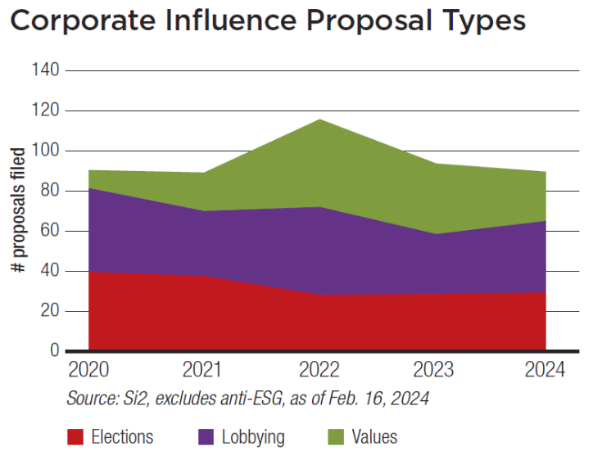
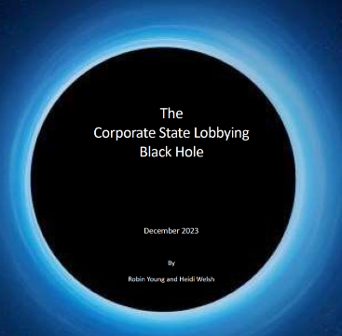
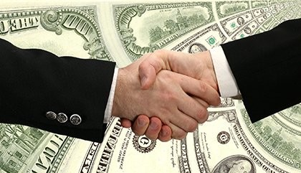
New Issues, Key Themes in 2024
Social Issues
Corporate Political Influence (about 90, even with 2023)
        Elections (30) Mostly new, at smaller companies
        Lobbying (34) one-third resubmissions; support retained in ‘23
        Values/consistency (25) policy ≠ supported politicians/groups
12 climate change, 13 other (reproductive & voting rights)
“Corporate Political Responsibility”
Will companies protect democracy or “go with the flow”?
New reports for investors, some on U.S. political risks
New state lobbying “black hole” report from Si2

Slide 18
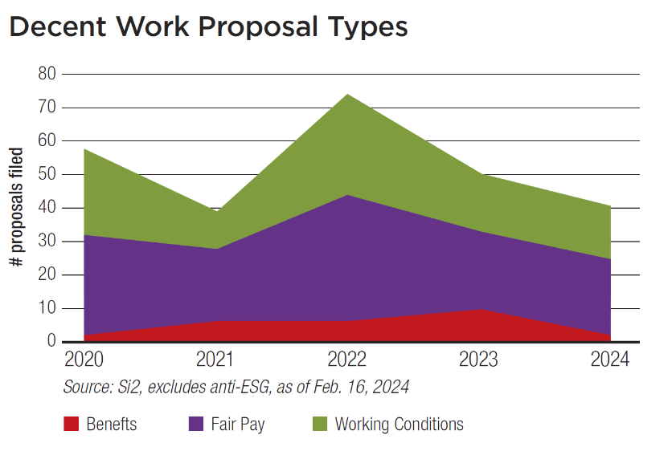



New Issues, Key Themes in 2024
Social Issues
Decent Work (41, down from >70 three years ago)
    Fair pay (23): Most again on gender/racial pay gaps
NEW: - “living wage” principles “ordinary business”
- Metrics pending: Amazon, Home Depot, Kohl’s
    Working conditions (14):
fair treatment, health & safety
Continuing bias ?s at Chipotle, Goldman Sachs, Tesla
NEW: 11 (up from 5) on health & safety audits, specific problems

Slide 19
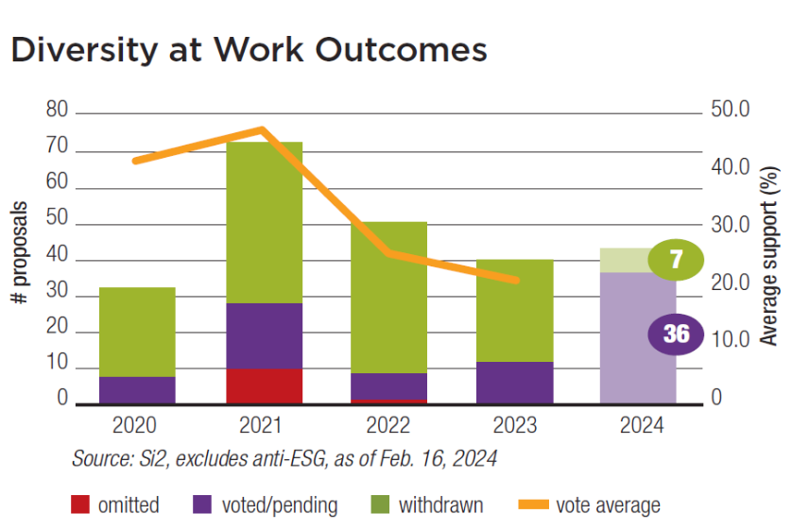


New Issues, Key Themes in 2024
Social Issues
Diversity at Work (38, down from 75 three years ago)
  More disclosure on DEI = fewer proposals, more withdrawals; outliers like Expeditors International (57% vote last year), mostly new target companies in 2024
  New report on “diversity benefit” in November 2023
  NEW: Explicit LGBTQ protections at International Paper, Lennar; including health benefits at J.B. Hunt Transport

Slide 20
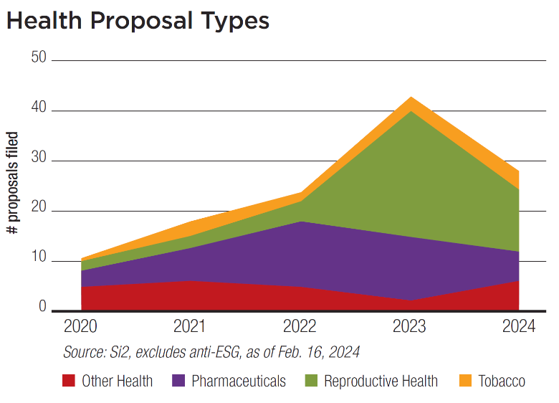

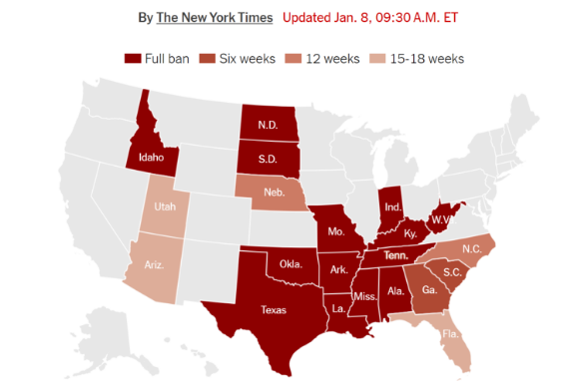
New Issues, Key Themes in 2024
Social Issues
Health
  Reproductive rights (12, down from 25 in 2023)
Post Roe landscape = new barriers to care, more workforce risks. SCOTUS mifepristone decision coming.
NEW: Impact on medical care in states restricting reproductive/ transgender care: Coca-Cola, McDonald’s
Tracking Abortion Bans Across the Country
      Pharmaceuticals (6, down from 13 in 2023)
Resubmitted “patent thicket” proposals (30%+ votes in 2023 and pending at AbbVie, Merck but Pfizerwithdrawn)

Slide 21
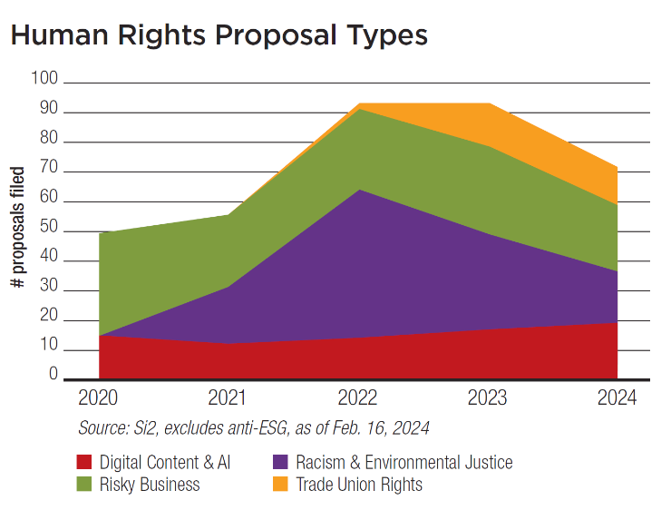


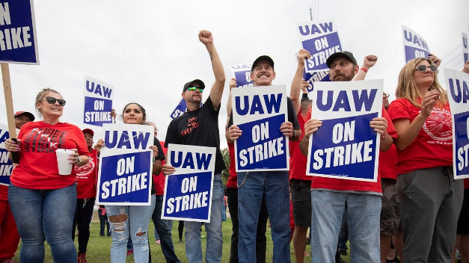
New Issues, Key Themes in 2024
Social Issues
Human Rights (71, down from 93 previous 2 years):
      Risky business (23): how policies implemented, what are risks?
NEW: “Right to health” still pending at Eli Lilly
Underwriting at JPM, controversial locations of Marriott, Mondelēz, TripAdvisor
Thermo Fisher Scientific to report (DNA tests in Tibet)
      Racism/EJ (12, down from 24 in 2023):
resubs at Amer. Water Works, GEO (previous 40% votes).
NEW: UnitedHealth (health disparities)
      Trade Union Rights (12, down from 15):
adopt or report on domestic ILO standards, focus on anti-union actions
NEW: Organizing Delta Air Lines, Netflix

Slide 22

New Issues, Key Themes in 2024
Social Issues
Human Rights (continued)
      The Digital World and AI (19, pivot from 14 in ‘23 on privacy/surveillance):
NEW: Ethical guidelines for AI use:
          SEC says not “ordinary business”
          First votes: Microsoft (21.2% in December), Apple 37.5%
          Expanding laws, regulation: White House TF, new EU Law
          Impact questions at Alphabet, Meta – children, political risk
Media: Comcast, Netflix, Paramount Global, Warner Bros.
Health bias, hiring decisions, layoffs, privacy, misinfo at UnitedHealth
MORE NEW:
U.S. political ad ban, non-US content harms (both at Meta)

Slide 23
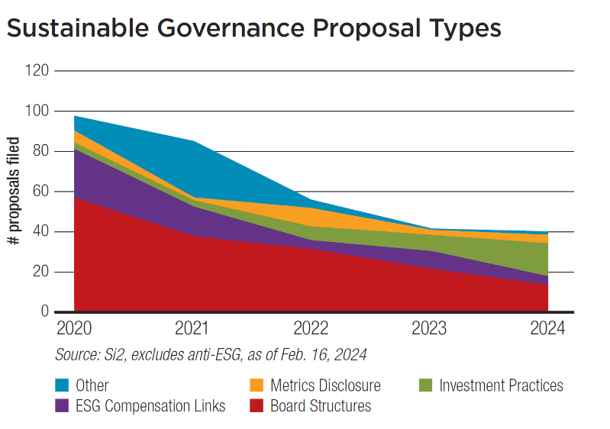

New Issues, Key Themes in 2024
Sustainable Governance
Board Structures & Oversight (12, down from 21 in 2023)
ESG Pay Links (5, down from 9 – all about climate change)
Metrics Disclosure (only 5 - all about climate change)
Investment Practices (16, up from 8)
NEW: Proxy voting congruency
… McRitchie: options for clients
to reflect their values
… ICCR: Regarding company
policy ≠ proxy vote choices

Slide 24
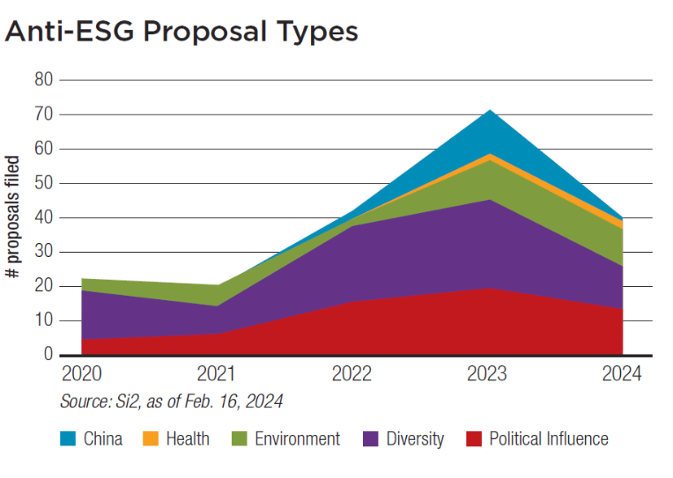
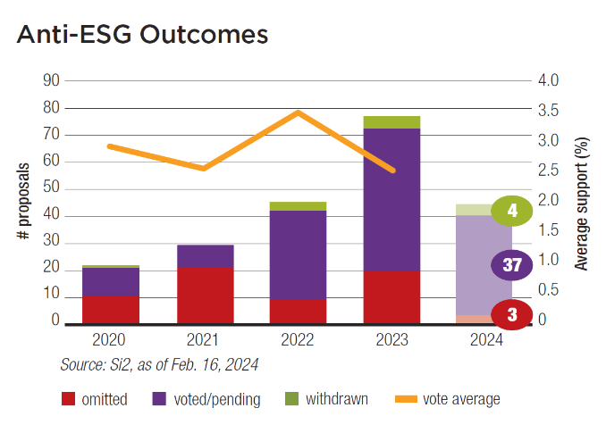

New Issues, Key Themes in 2024
Anti-ESG
More volume: Filings way up – more than 80 like last year?
No support: Average 2.5% in 2023 (5% needed to resubmit)
Dark money funding
Social policy focus
(37 pending out of
45+ filed)
Diversity: “viewpoint diversity” complaint,
many more anti-transgender proposals in 2024
Political influence: Companies, boards “too left”
Environment: more in last 2 years, question
climate change mitigation efforts

Slide 25
About Si2
Funded by colleges, universities, pension funds, asset owners with AUM > $5 trillion
Careful, impartial tracking and analysis of corporate reform campaigns and issues
Briefing Papers
In-depth topic analyses
Action Reports
Company-specific analysis 3-4 weeks before annual meetings
Engagement Monitor
Interactive online database
Prospectively identifies issues
Tracks outcomes
Proxy Season Analysis
Pre- and post-season assessments
Weekly email updates in season
Special Projects
Reports for the public on Si2 website on corporate political activity, climate change, integrated reporting and more.
Contact
Heidi Welsh, Executive Director
heidi @ siinstitute.org
+1-301-432-4721
www.siinstitute.org
Notes:
Continued political $ focus: “connective tissue”

Slide 26


Climate and Energy
Michael Passoff
CEO
Proxy Impact

Slide 27

2024 Climate Related Proposals
Transition Planning: 42
Climate Impacts: 25
Emissions Targets: 21
Carbon Finance: 17
Climate Lobbying: 12
CEO Pay / Retirement: 7
Notes:
Continued political $ focus: “connective tissue”

Slide 28

Transition Planning
Shareholders asking for:
Adopt plans or report on preparations for a transition to a lower- or no-carbon economy
GHG emissions reduction
Science-based targets
Meets Paris Agreement 1.5C goal / net zero
Best practices
Creates accountability
Integrated into business strategy
Is forward looking
Time bound and quantitative
Flexible and responsive
Notes:
Continued political $ focus: “connective tissue”

Slide 29
Company | Scopes |  | Timeframe
 | 1-2 | 3 | Short | Medium | Long | “science-based”
Air Transport Services | X | X | X |  | X
American Int’l Group | X | X |  |  |  | z
Archer-Daniels-Midland |  |  |  |  | X | X
Berry | X | X | X |  | X
Broadcom Limited | X | X | X |  | X | X
C.H. Robinson
Centene |  |  |  | X | X | X
Chevron | X | X |  | X
Cleveland-Cliffs | X | X |  |  |  | X
Exxon Mobil | X | X |  | X
Home Depot | X | X
Illinois Tool Works | X | X | X | X | X | X
Emissions Targets
Timeline and Goals
Science-based targets
Meets Paris Agreement 1.5C goal / net zero
Types of Emissions
Scope 1: direct operational GHGs
Scope 2: from indirect electricity purchases
Scope 3; other indirect emissions up and down the value chain that include supply chains and products
Notes:
Continued political $ focus: “connective tissue”

Slide 30

SEC Climate Disclosure Rule
Climate related disclosure in annual reports beginning 2026:
Extensions for large companies, exemptions for small companies
Climate risk impact on company strategy, business model and outlook
Risk management processes: targets and goals
Scope 1 and 2 reporting
Scope 3 not required
Key considerations:
Companies only have to report on what the company deems to be material.
Materiality is deemed to be what is of interest to investors.
Lots of room for shareholder engagement
Lawsuits could tie up rules for years
Notes:
Continued political $ focus: “connective tissue”

Slide 31
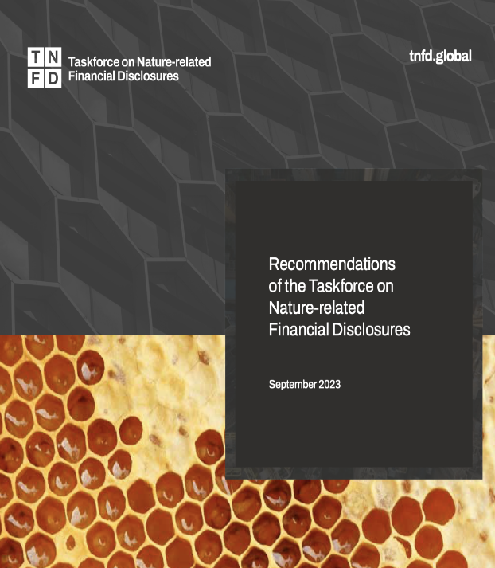

Biodiversity
“The future of all living things on our planet, and our future prosperity, depends on the resilience of nature.”
The Taskforce on Nature-related Financial Disclosures (TNFD)
Impacts on the Web of Life
Pollution
Toxics
Deforestation
Habitat loss
Species loss
Notes:
Continued political $ focus: “connective tissue”

Slide 32

___________________________________________________________________
A proxy voting and shareholder engagement service for
sustainable and impact investors
    ESG vote guidelines
    Proxy voting and reporting
    Shareholder engagement on social & environmental issues
Contact Michael Passoff, michael@proxyimpact.com www.proxyimpact.com
Notes:
Continued political $ focus: “connective tissue”

Slide 33
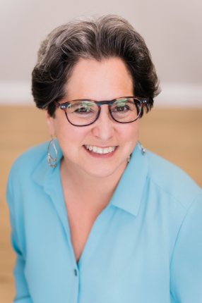

Social Topics: Political Spending Misalignment, Reproductive & Maternal Healthcare
Shelley Alpern
Director of Corporate Engagement
Associate Vice President
Notes:
Continued political $ focus: “connective tissue”

Slide 34

Political Spending Misalignment:
How Can Companies Reduce the Conflict Between Their Spending and Their Values?
Four pillars of responsible corporate political participation
Transparency Governance Oversight Accountability
Notes:
Continued political $ focus: “connective tissue”

Slide 35

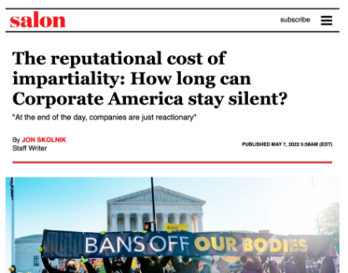

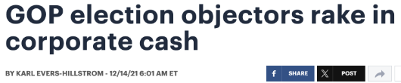
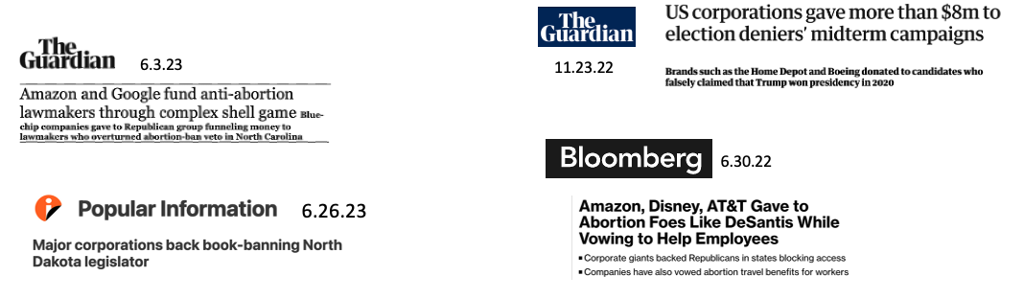
Notes:
Continued political $ focus: “connective tissue”

Slide 36
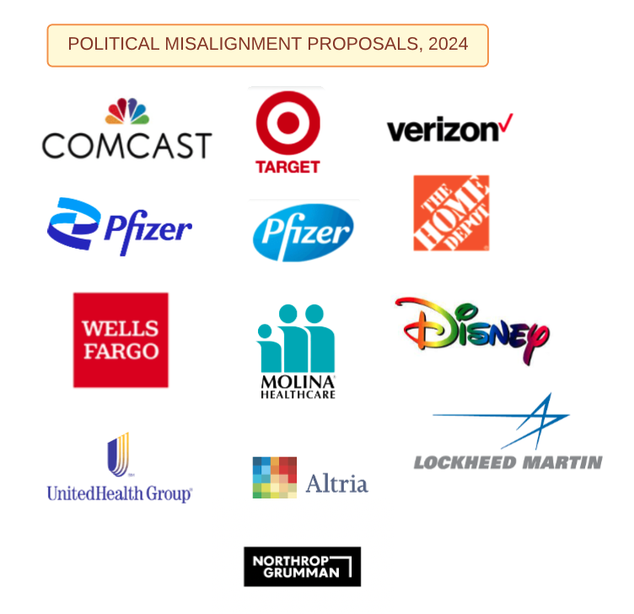
Notes:
Continued political $ focus: “connective tissue”

Slide 37
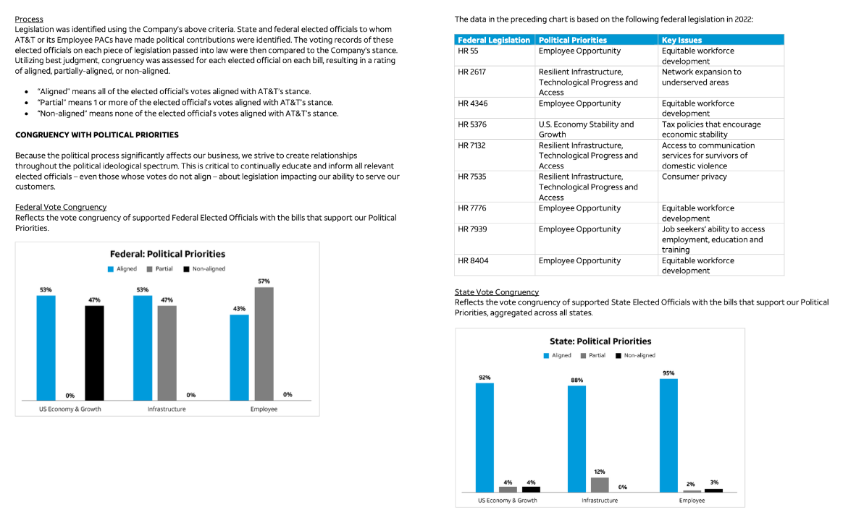
Notes:
Continued political $ focus: “connective tissue”

Slide 38
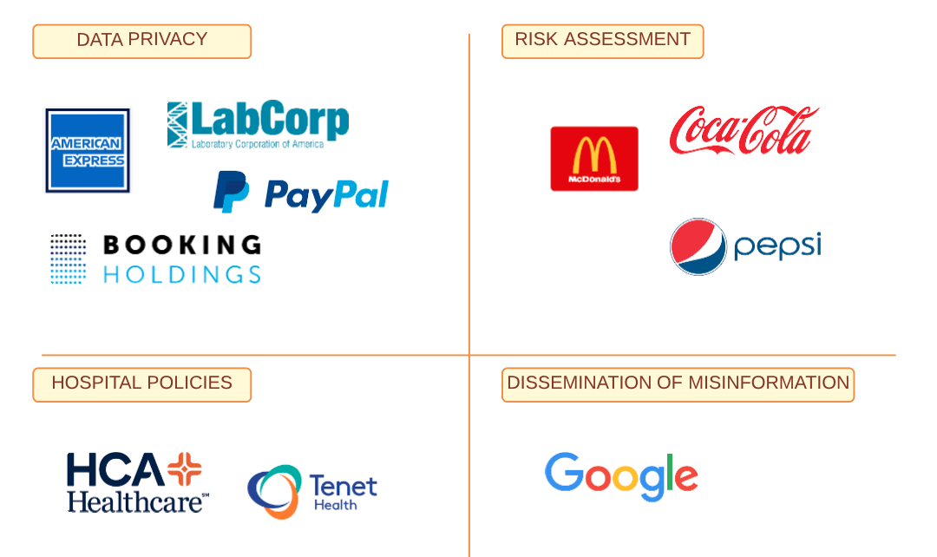
Notes:
Continued political $ focus: “connective tissue”

Slide 39



Questions and Answers
Use the Q&A window to send us your questions
Michael Passoff
Proxy Impact
Heidi Welsh
Sustainable Investments Institute (Si2)
Q&A Window
Shelley Alpern
Rhia Ventures
Notes:
Continued political $ focus: “connective tissue”

Slide 40

Closing Remarks
Heidi Welsh
Sustainable Investments Institute (Si2)
Michael Passoff
Proxy Impact
Shelley Alpern
Rhia Ventures
Notes:
Continued political $ focus: “connective tissue”

Slide 41

More on www.proxypreview.org
Download Proxy Preview 2024
Sign up to follow Proxy Season Updates
Watch a recording of this presentation
Meet the contributing authors
Learn more about shareholder advocacy
Notes:
Continued political $ focus: “connective tissue”

Slide 42
Contact Us
Media/Press Contact
Sophia Wilson
(341) 600-1832
swilson@asyousow.org
Download the report at
www.proxypreview.org
Notes:
Continued political $ focus: “connective tissue”

Slide 43
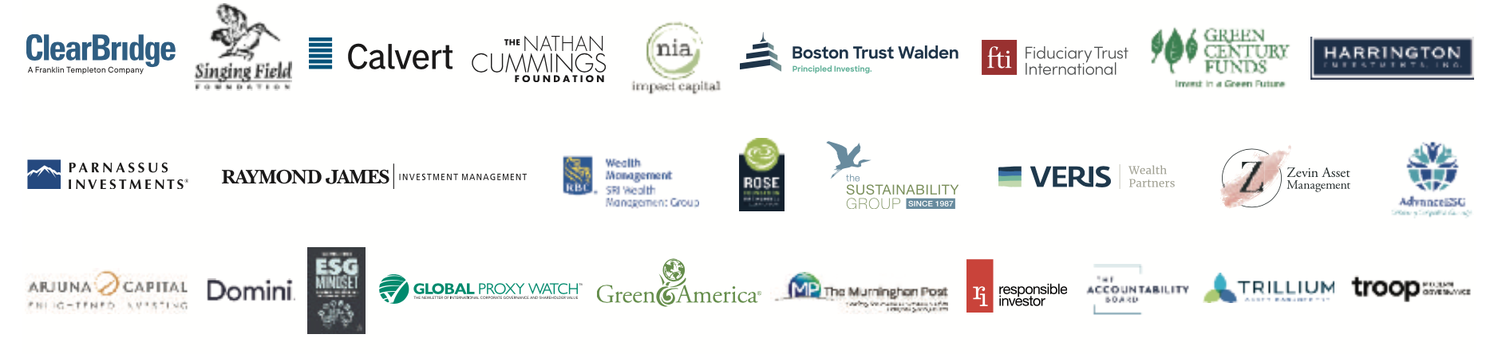

Thank you to our sponsors!

Slide 44
DISCLAIMER
The information provided on this website and all reports is provided “AS IS” without warranty of any kind. As You Sow, Proxy Impact, and Sustainable Investments Institute make no representations and provide no warranties regarding any information or opinions provided herein, including, but not limited to, the advisability of investing in any particular company or investment fund or other vehicle. While we have obtained information believed to be objectively reliable, As You Sow, Proxy Impact, and Sustainable Investments Institute nor any of their employees, officers, directors, trustees, or agents, shall be responsible or liable, directly or indirectly, for any damage or loss caused or alleged to be caused by or in connection with use of or reliance on any information contained herein, including, but not limited to, lost profits or punitive or consequential damages. Past performance is not indicative of future returns.
As You Sow, Proxy Impact, and Sustainable Investments Institute do not provide investment, financial planning, legal, or tax advice. We are neither licensed nor qualified to provide any such advice. The content of our programming, publications, and presentations is provided for informational and educational purposes only, and is neither appropriate nor intended to be used for the purposes of making any decisions on investing, purchases, sales, trades, or any other investment transactions.
Our events, websites, and promotional materials may contain external links to other resources, and may contain comments or statements by individuals who do not represent As You Sow, Proxy Impact, and Sustainable Investments Institute. As You Sow, Proxy Impact, and Sustainable Investments Institute have no control over, and assume no responsibility for, the content, privacy policies, or practices of any third party web sites or services that you may access as a result of our programming. As You Sow, Proxy Impact, and Sustainable Investments Institute shall not be responsible or liable, directly or indirectly, for any damage or loss caused or alleged to be caused by or in connection with use of or reliance on any such content, goods, or services available on or through any such web sites or services.
See our full disclaimer on our website https://www.proxypreview.org/legal
Notes:
Continued political $ focus: “connective tissue”

Slide 45
Thank You for Joining Us!
Download the full report at
www.proxypreview.org
March 14, 2024
Notes:
Continued political $ focus: “connective tissue”

